Slide 1

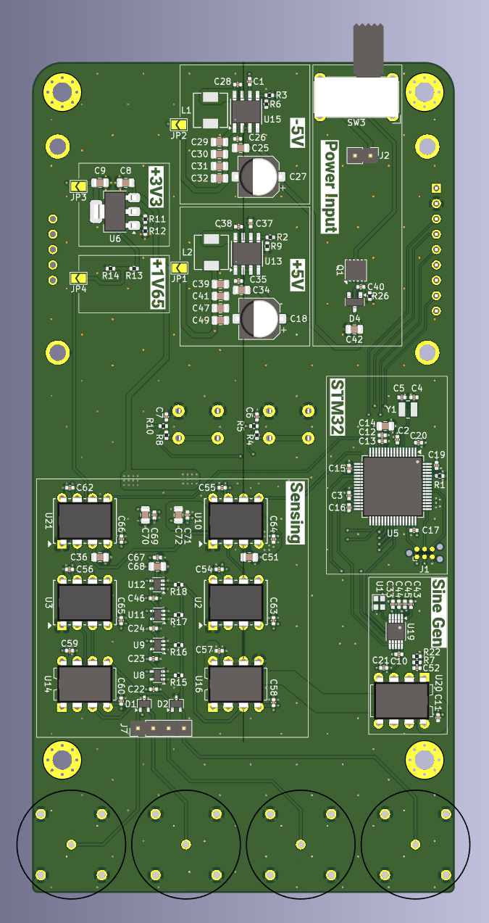
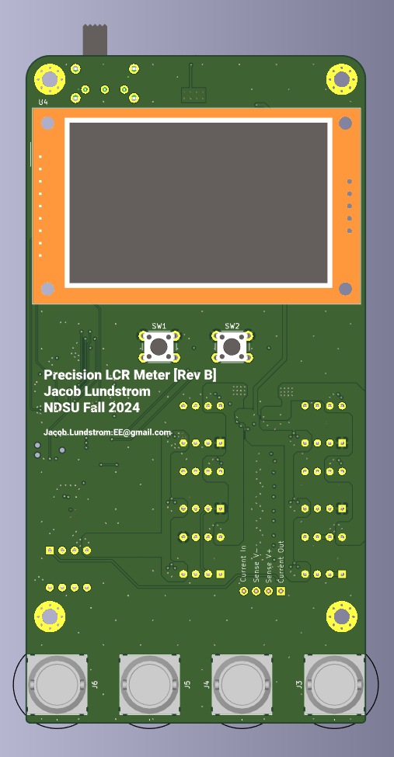
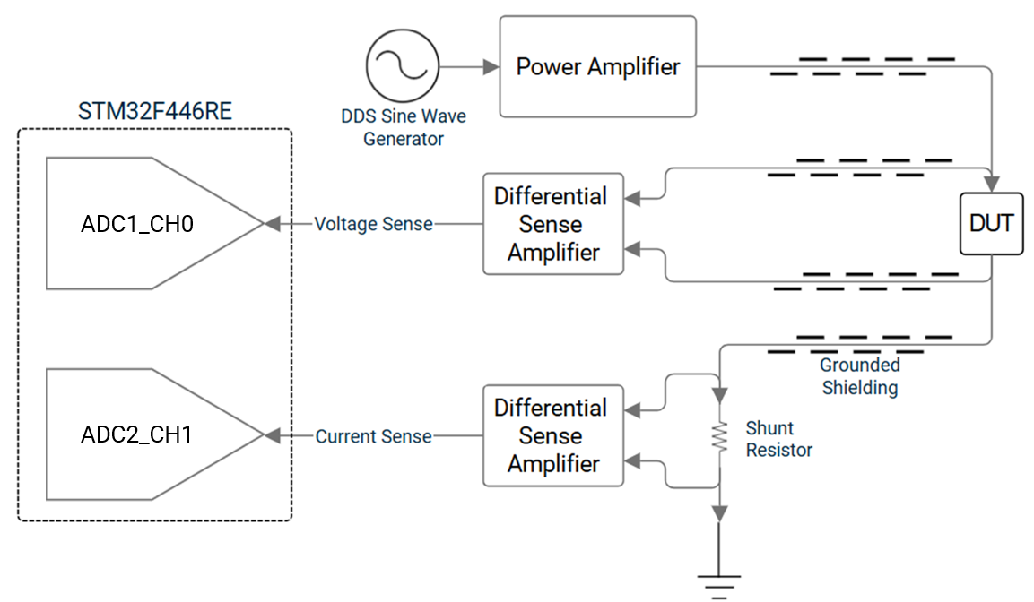
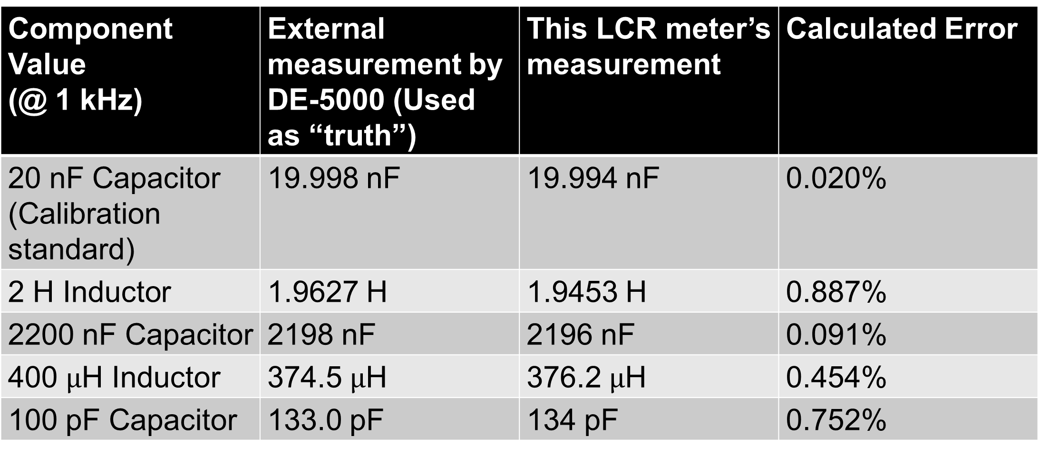
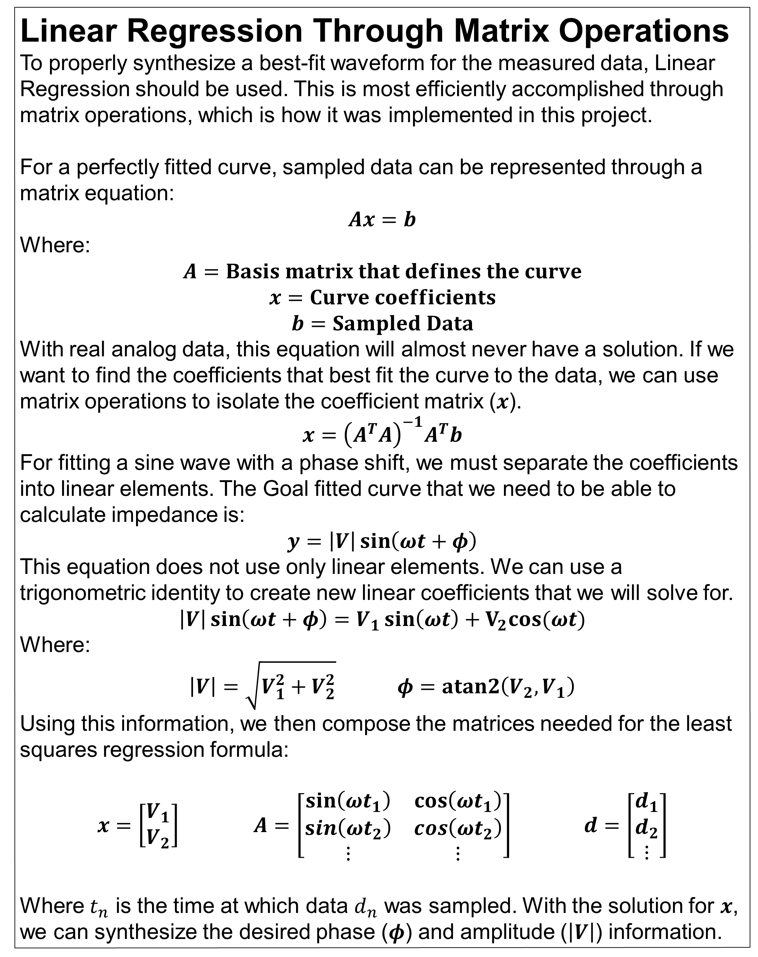
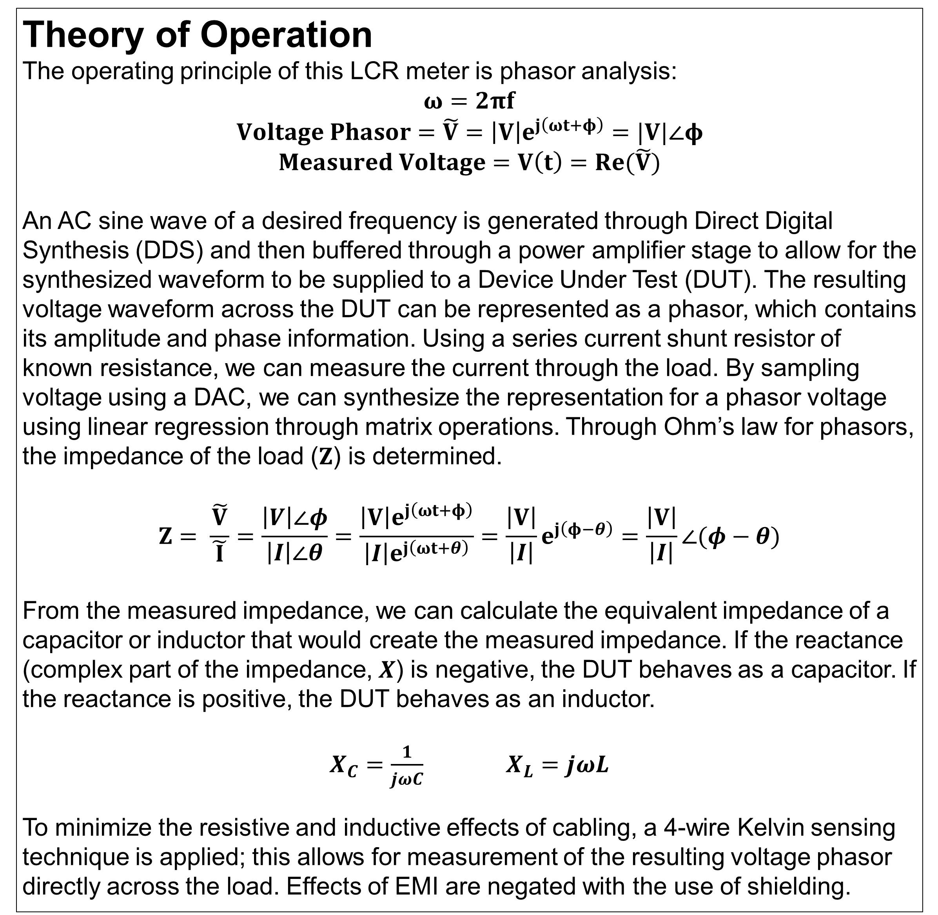

NDSU
Precision LCR Meter
Electrical and Computer Engineering
Team Members: Jacob Lundstrom
SENIOR DESIGN 2024
SD405_FA24_03
Mentor(s): Dr. Jacob Glower
Sponsor: Dr. Jacob Glower
Project Description
The Precision LCR meter is designed to measure electronic components (Inductors, Capacitors, Resistors) and analyze their impedance through phasor analysis to as high of a degree as is possible, with a target accuracy of <1%.
Linear Regression Through Matrix Operations
To properly synthesize a best-fit waveform for the measured data, Linear Regression should be used. This is most efficiently accomplished through matrix operations, which is how it was implemented in this project.
For a perfectly fitted curve, sampled data can be represented through a matrix equation:
$$Ax=b$$
Where:
$$A=Basis matrix that defines the curve$$
$$x=Curve coefficients$$
$$b=Sampled Data$$
With real analog data, this equation will almost never have a solution. If we want to find the coefficients that best fit the curve to the data, we can use matrix operations to isolate the coefficient matrix ($x$).
$$x={\left(A^{T}A\right)}^{−1}A^{T}b$$
For fitting a sine wave with a phase shift, we must separate the coefficients into linear elements. The Goal fitted curve that we need to be able to calculate impedance is:
$$y=\left|V\right|\sin\left(ωt+φ\right)$$
This equation does not use only linear elements. We can use a trigonometric identity to create new linear coefficients that we will solve for.
$$\left|V\right|\sin\left(ωt+φ\right)=V_{1}\sin\left(ωt\right)+V_{2}cos⁡(ωt)$$
Where:
$\left|V\right|=\sqrt{V_{1}^{2}+V_{2}^{2}}$ $φ=atan2\left(V_{2}, V_{1}\right)$
Using this information, we then compose the matrices needed for the least squares regression formula:
$x=\left[\begin{matrix}V_{1} \\ V_{2}\end{matrix}\right]$ $A=\left[\begin{matrix}\sin\left(ωt_{1}\right) & \cos\left(ωt_{1}\right) \\ \sin\left(ωt_{2}\right) & \cos\left(ωt_{2}\right) \\ ⋮ & ⋮\end{matrix}\right]$ $d=\left[\begin{matrix}d_{1} \\ d_{2} \\ ⋮\end{matrix}\right]$
Where $t_{n}$ is the time at which data $d_{n}$ was sampled. With the solution for $x$, we can synthesize the desired phase ($φ$) and amplitude ($\left|V\right|$) information.
Theory of Operation
The operating principle of this LCR meter is phasor analysis:
$$ω=2πf$$
$$Voltage Phasor=\tilde{V}=\left|V\right|e^{j\left(ωt+φ\right)}=|V|∠φ$$
$$Measured Voltage=V\left(t\right)=Re(\tilde{V})$$
An AC sine wave of a desired frequency is generated through Direct Digital Synthesis (DDS) and then buffered through a power amplifier stage to allow for the synthesized waveform to be supplied to a Device Under Test (DUT). The resulting voltage waveform across the DUT can be represented as a phasor, which contains its amplitude and phase information. Using a series current shunt resistor of known resistance, we can measure the current through the load. By sampling voltage using a DAC, we can synthesize the representation for a phasor voltage using linear regression through matrix operations. Through Ohm’s law for phasors, the impedance of the load ($Z$) is determined.
$$Z= \frac{\tilde{V}}{\tilde{ I }}=\frac{\left|V\right|∠φ}{\left|I\right|∠θ}=\frac{\left|V\right|e^{j\left(ωt+φ\right)}}{\left|I\right|e^{j\left(ωt+θ\right)}}=\frac{\left|V\right|}{\left|I\right|}e^{j\left(φ−θ\right)}=\frac{\left|V\right|}{\left|I\right|}∠(φ−θ)$$
From the measured impedance, we can calculate the equivalent impedance of a capacitor or inductor that would create the measured impedance. If the reactance (complex part of the impedance, $X$) is negative, the DUT behaves as a capacitor. If the reactance is positive, the DUT behaves as an inductor.
$X_{C}=\frac{1}{jωC}$ $X_{L}=jωL$
To minimize the resistive and inductive effects of cabling, a 4-wire Kelvin sensing technique is applied; this allows for measurement of the resulting voltage phasor directly across the load. Effects of EMI are negated with the use of shielding.
Results
Capable Sine wave generation: 0 Hz to 100 kHz
Generated Sine wave amplitude: 0.6 Vpp + 0.3 VDC
Smallest resolution of measurable Capacitance: 1 pF
Smallest resolution of measurable Inductance: 10 $μ$H
Component measurements:
This device is also capable of measuring Parasitic Capacitance:
Calibration standard isolated: 19.994 nF
Calibration standard with hand in contact: 20.385 nF
Hand parasitic capacitance is ~389 pF! Stronger contact yields higher capacitance.
System
Block
Diagram
Bill of Materials
The components listed here are the most important ones; for a more detailed BOM with passives and other excluded components, visit the GitHub page!
Component Value (@ 1 kHz) | External measurement by DE-5000 (Used as “truth”) | This LCR meter’s measurement | Calculated Error
20 nF Capacitor (Calibration standard) | 19.998 nF | 19.994 nF | 0.020%
2 H Inductor | 1.9627 H | 1.9453 H | 0.887%
2200 nF Capacitor | 2198 nF | 2196 nF | 0.091%
400 $μ$H Inductor | 374.5 $μ$H | 376.2 $μ$H | 0.454%
100 pF Capacitor | 133.0 pF | 134 pF | 0.752%
Reference Designator | Qty | Component MFG P/N | Function
U1 | 1 | KC2016Z20.0000C15XXK | Reference Oscillator for Sine wave Generator
U10, U2, U21, U3 | 4 | AMP03GPZ | Precision differential amplifier for sensing
U11, U12, U8, U9 | 4 | TMUX1101DCKR | Muxes used for switching current shunt resistors
U13, U15 | 2 | LMR33640DDDAR | Buck converters
U14, U16, U20 | 3 | LM833N/NOPB | Sensing buffer amplifiers, sine wave power amplifier
U19 | 1 | AD9833BRMZ | Sine wave DDS generator
U5 | 1 | STM32F446RET6TR | Main MCU
U6 | 1 | LM1117MP-ADJ/NOPB | Adjustable linear regulator
Y1 | 1 | CG04874-8M | MCU oscillator
Want to know more? This project is open source!
Software: https://github.com/Jacob-Lundstrom/lcr-meter-software
Hardware: https://github.com/Jacob-Lundstrom/lcr-meter-hardware
`
STUDENT FOCUSED
LAND GRANT
RESEARCH UNIVERSITY

